Slide 1
Chapter 8 Sequential-Access Files
C++ How to Program,
Late Objects Version, 7/e

Slide 2
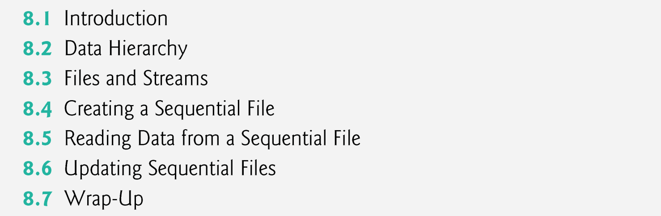

Slide 3
8.1 Introduction
Storage of data in memory is temporary.
Files are used for data persistence—permanent retention of data.
Computers store files on secondary storage devices, such as hard disks, CDs, DVDs, flash drives and tapes.
In this chapter, we explain how to build C++ programs that create, update and process sequential files.

Slide 4
8.3 Files and Streams
C++ views each file as a sequence of bytes (Fig. 8.2).
Each file ends either with an end-of-file marker or at a specific byte number recorded in an operating-system-maintained, administrative data structure.
When a file is opened, an object is created, and a stream is associated with the object.
In Chapter 15, we saw that objects cin, cout, cerr and clog are created when <iostream> is included.
The streams associated with these objects provide communication channels between a program and a particular file or device.

Slide 5
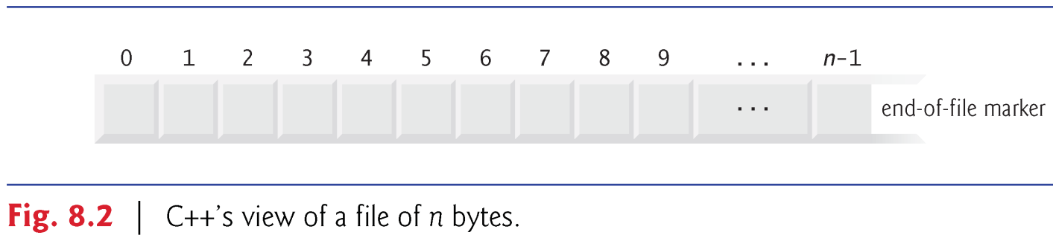
8.3 Files and Streams (cont.)
To perform file processing in C++, header files <iostream> and <fstream> must be included.

Slide 6
8.4 Creating a Sequential File
C++ imposes no structure on a file.
Thus, a concept like that of a “record” does not exist in a C++ file.
You must structure files to meet the application’s requirements.
Figure 8.3 creates a sequential file that might be used in an accounts-receivable system to help manage the money owed by a company’s credit clients.
For each client, the program obtains the client’s account number, name and balance (i.e., the amount the client owes the company for goods and services received in the past).

Slide 7
8.4 Creating a Sequential File
The data obtained for each client constitutes a record for that client.
The account number serves as the record key.
This program assumes the user enters the records in account number order.
In a comprehensive accounts receivable system, a sorting capability would be provided to eliminate this restriction.

Slide 8
int main()
{
ofstream outClientFile( "clients.txt", ios::out );
if ( !outClientFile )
{
cerr << "File could not be opened" << endl;
system( "pause" );
exit( 1 );
}
int account[] = { 100, 200, 300, 400, 500 };
string name[] = { "Jones", "Doe", "White", "Stone", "Rich" };
double balance[] = { 24.98, 345.67, 0.00, -42.16, 224.62 };
for( int i = 0; i < 5; i++ )
outClientFile << account[ i ] << ' ' << name[ i ] << ' '
<< balance[ i ] << endl;
}

Slide 9
int account[] = { 100, 200, 300, 400, 500 };
string name[] = { "Jones", "Doe", "White", "Stone", "Rich" };
double balance[] = { 24.98, 345.67, 0.00, -42.16, 224.62 };
for( int i = 0; i < 5; i++ )
outClientFile << account[ i ] << ' ' << name[ i ] << ' '
<< balance[ i ] << endl;
 | account | name | balance
0 | 100 | Jones | 24.98
1 | 200 | Doe | 345.67
2 | 300 | White | 0.00
3 | 400 | Stone | -42.16
4 | 500 | Rich | 224.62
clients.dat

Slide 10
int account[] = { 100, 200, 300, 400, 500 };
string name[] = { "Jones", "Doe", "White", "Stone", "Rich" };
double balance[] = { 24.98, 345.67, 0.00, -42.16, 224.62 };
for( int i = 0; i < 5; i++ )
outClientFile << account[ i ] << ' ' << name[ i ] << ' '
<< balance[ i ] << endl;
 | account | name | balance
0 | 100 | Jones | 24.98
1 | 200 | Doe | 345.67
2 | 300 | White | 0.00
3 | 400 | Stone | -42.16
4 | 500 | Rich | 224.62
100 Jones 24.98
clients.dat

Slide 11
int account[] = { 100, 200, 300, 400, 500 };
string name[] = { "Jones", "Doe", "White", "Stone", "Rich" };
double balance[] = { 24.98, 345.67, 0.00, -42.16, 224.62 };
for( int i = 0; i < 5; i++ )
outClientFile << account[ i ] << ' ' << name[ i ] << ' '
<< balance[ i ] << endl;
 | account | name | balance
0 | 100 | Jones | 24.98
1 | 200 | Doe | 345.67
2 | 300 | White | 0.00
3 | 400 | Stone | -42.16
4 | 500 | Rich | 224.62
100 Jones 24.98
200 Doe 345.67
clients.dat

Slide 12
int account[] = { 100, 200, 300, 400, 500 };
string name[] = { "Jones", "Doe", "White", "Stone", "Rich" };
double balance[] = { 24.98, 345.67, 0.00, -42.16, 224.62 };
for( int i = 0; i < 5; i++ )
outClientFile << account[ i ] << ' ' << name[ i ] << ' '
<< balance[ i ] << endl;
 | account | name | balance
0 | 100 | Jones | 24.98
1 | 200 | Doe | 345.67
2 | 300 | White | 0.00
3 | 400 | Stone | -42.16
4 | 500 | Rich | 224.62
100 Jones 24.98
200 Doe 345.67
300 White 0
clients.dat

Slide 13
int account[] = { 100, 200, 300, 400, 500 };
string name[] = { "Jones", "Doe", "White", "Stone", "Rich" };
double balance[] = { 24.98, 345.67, 0.00, -42.16, 224.62 };
for( int i = 0; i < 5; i++ )
outClientFile << account[ i ] << ' ' << name[ i ] << ' '
<< balance[ i ] << endl;
 | account | name | balance
0 | 100 | Jones | 24.98
1 | 200 | Doe | 345.67
2 | 300 | White | 0.00
3 | 400 | Stone | -42.16
4 | 500 | Rich | 224.62
100 Jones 24.98
200 Doe 345.67
300 White 0
400 Stone -42.16
clients.dat

Slide 14
int account[] = { 100, 200, 300, 400, 500 };
string name[] = { "Jones", "Doe", "White", "Stone", "Rich" };
double balance[] = { 24.98, 345.67, 0.00, -42.16, 224.62 };
for( int i = 0; i < 5; i++ )
outClientFile << account[ i ] << ' ' << name[ i ] << ' '
<< balance[ i ] << endl;
 | account | name | balance
0 | 100 | Jones | 24.98
1 | 200 | Doe | 345.67
2 | 300 | White | 0.00
3 | 400 | Stone | -42.16
4 | 500 | Rich | 224.62
100 Jones 24.98
200 Doe 345.67
300 White 0
400 Stone -42.16
500 Rich 224.62
clients.dat

Slide 15
1 // Fig. 8.3: fig8_03.cpp
2 // Create a sequential file.
3 #include <iostream>
4 #include <string>
5 #include <fstream> // file stream
6 #include <cstdlib>
7 using namespace std;
8
9 int main()
10 {
11 // ofstream constructor opens file
12 ofstream outClientFile( "clients.dat", ios::out );
13
14 // exit program if unable to create file
15 if ( !outClientFile ) // overloaded ! operator
16 {
17 cerr << "File could not be opened" << endl;
18 exit( 1 );
19 } // end if

Slide 16
20
21 cout << "Enter the account, name, and balance." << endl
22 << "Enter end-of-file to end input.\n? ";
23
24 int account; // customer’s account number
25 string name; // customer’s name
26 double balance; // amount of money customer owes company
27
28 // read account, name and balance from cin, then place in file
29 while ( cin >> account >> name >> balance )
30 {
31 outClientFile << account << ' ' << name << ' '
<< balance << endl;
32 cout << "? ";
33 } // end while
34 } // end main

Slide 17
Enter the account, name, and balance.
Enter end-of-file to end input.
? 100 Jones 24.98
? 200 Doe 345.67
? 300 White 0.00
? 400 Stone -42.16
? 500 Rich 224.62
? ^Z

Slide 18
while ( cin >> account >> name >> balance )
{
outClientFile << account << ' ' << name << ' ' << balance << endl;
cout << "? ";
}
account
name
balance
clients.dat

Slide 19
while ( cin >> account >> name >> balance )
{
outClientFile << account << ' ' << name << ' ' << balance << endl;
cout << "? ";
}
account | 100
name | Jones
balance | 24.98
clients.dat

Slide 20
while ( cin >> account >> name >> balance )
{
outClientFile << account << ' ' << name << ' ' << balance << endl;
cout << "? ";
}
100 Jones 24.98
account | 100
name | Jones
balance | 24.98
clients.dat

Slide 21
while ( cin >> account >> name >> balance )
{
outClientFile << account << ' ' << name << ' ' << balance << endl;
cout << "? ";
}
100 Jones 24.98
account | 200
name | Joe
balance | 345.67
clients.dat

Slide 22
while ( cin >> account >> name >> balance )
{
outClientFile << account << ' ' << name << ' ' << balance << endl;
cout << "? ";
}
100 Jones 24.98
200 Doe 345.67
account | 200
name | Joe
balance | 345.67
clients.dat

Slide 23
while ( cin >> account >> name >> balance )
{
outClientFile << account << ' ' << name << ' ' << balance << endl;
cout << "? ";
}
100 Jones 24.98
200 Doe 345.67
account | 300
name | White
balance | 0.00
clients.dat

Slide 24
while ( cin >> account >> name >> balance )
{
outClientFile << account << ' ' << name << ' ' << balance << endl;
cout << "? ";
}
100 Jones 24.98
200 Doe 345.67
300 White 0
account | 300
name | White
balance | 0.00
clients.dat

Slide 25
while ( cin >> account >> name >> balance )
{
outClientFile << account << ' ' << name << ' ' << balance << endl;
cout << "? ";
}
100 Jones 24.98
200 Doe 345.67
300 White 0
account | 400
name | Stone
balance | -42.16
clients.dat

Slide 26
while ( cin >> account >> name >> balance )
{
outClientFile << account << ' ' << name << ' ' << balance << endl;
cout << "? ";
}
100 Jones 24.98
200 Doe 345.67
300 White 0
400 Stone -42.16
account | 400
name | Stone
balance | -42.16
clients.dat

Slide 27
while ( cin >> account >> name >> balance )
{
outClientFile << account << ' ' << name << ' ' << balance << endl;
cout << "? ";
}
100 Jones 24.98
200 Doe 345.67
300 White 0
400 Stone -42.16
account | 500
name | Rich
balance | 224.62
clients.dat

Slide 28
while ( cin >> account >> name >> balance )
{
outClientFile << account << ' ' << name << ' ' << balance << endl;
cout << "? ";
}
100 Jones 24.98
200 Doe 345.67
300 White 0
400 Stone -42.16
500 Rich 224.62
account | 500
name | Rich
balance | 224.62
clients.dat

Slide 29
8.4 Creating a Sequential File (cont.)
In Fig. 8.3, the file is to be opened for output, so an ofstream object is created.
Two arguments are passed to the object’s constructor—the filename and the file-open mode (line 12).
For an ofstream object, the file-open mode can be either ios::out to output data to a file or ios::app to append data to the end of a file (without modifying any data already in the file).
Existing files opened with mode ios::out are truncated—all data in the file is discarded.
If the specified file does not yet exist, then the ofstream object creates the file, using that filename.

Slide 30
8.4 Creating a Sequential File (cont.)
The ofstream constructor opens the file—this establishes a “line of communication” with the file.
By default, ofstream objects are opened for output, so the open mode is not required in the constructor call.
Figure 8.4 lists the file-open modes.

Slide 31
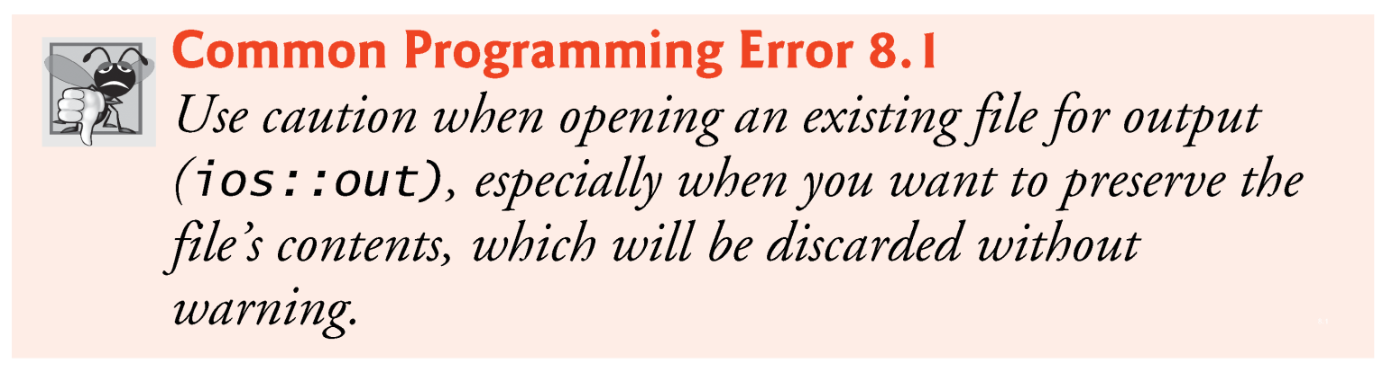

Slide 32
8.4 Creating a Sequential File (cont.)
Mode Description
ios::in Open a file for input.
ios::out Open a file for output.
ios::binary Open a file for binary (i.e., nontext) input or output.

Slide 33
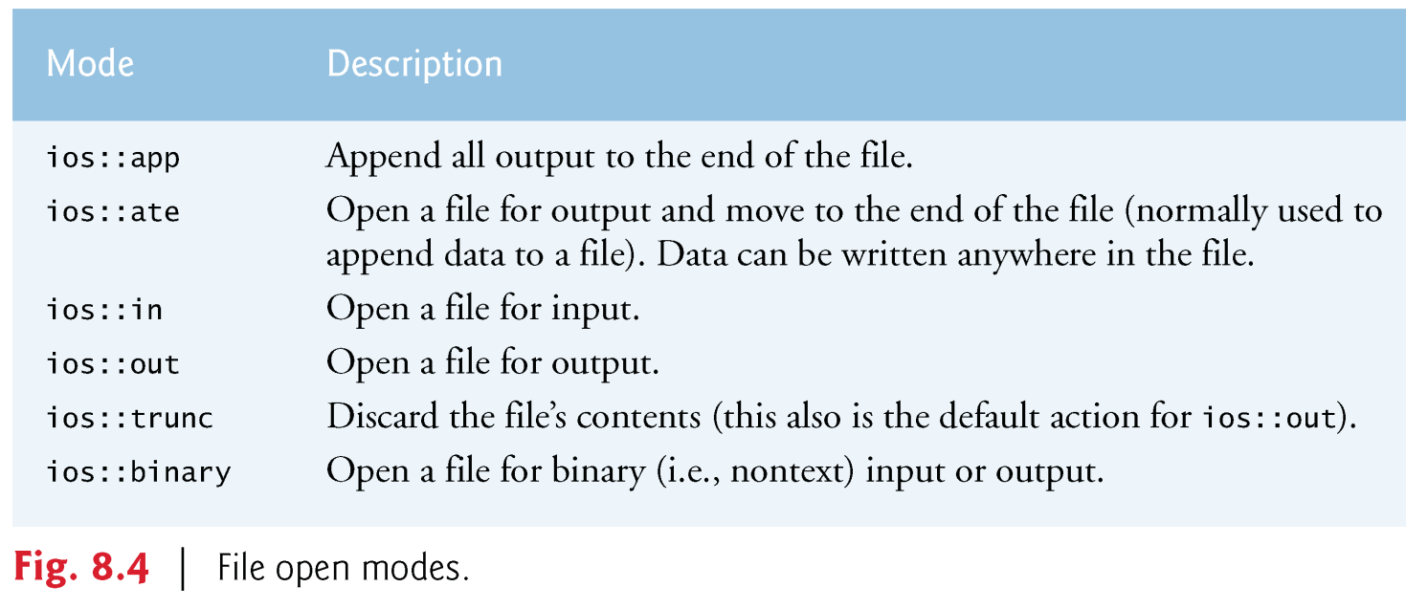

Slide 34
8.4 Creating a Sequential File (cont.)
An ofstream object can be created without opening a specific file—a file can be attached to the object later.
For example, the statement
ofstream outClientFile;
creates an ofstream object named outClientFile.
The ofstream member function open opens a file and attaches it to an existing ofstream object as follows:
outClientFile.open("clients.txt", ios::out);

Slide 35
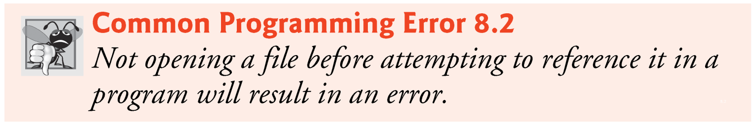

Slide 36
8.4 Creating a Sequential File (cont.)
After creating an ofstream object and attempting to open it, the program tests whether the open operation was successful.
The condition in the if statement in lines 15–19 returns true if the open operation failed.
Some possible errors are
attempting to open a nonexistent file for reading,
attempting to open a file for reading or writing without permission, and
opening a file for writing when no disk space is available.

Slide 37
8.4 Creating a Sequential File (cont.)
!outClientFile
Returns true if badbit or failbit set.
Opened non-existent file for reading, wrong permissions
( cin >> myVariable )
false when failbit or badbit set, otherwise true.
failbit set when end-of-file indicator (ctrl-z) is entered.
while( cin >> myVariable )
Loops until end-of-file indicator (ctrl-z) is entered.

Slide 38
8.4 Creating a Sequential File (cont.)
Four state bits of an input stream (cin)
failbit: is set for a stream when a format error occurs on the stream.
badbit: is set for a stream when an error occurs that results in the loss of data.
eofbit: is set for a stream after end-of-file is encountered.
goodbit: is set for a stream if none of the bits eofbit, failbit or badbit is set for the stream.
fileObject.clear()
sets the goodbit and resets the eofbit, failbit and badbit.

Slide 39
8.4 Creating a Sequential File (cont.)
Function exit terminates a program.
The argument to exit is returned to the environment from which the program was invoked.
Argument 0 indicates that the program terminated normally; any other value indicates that the program terminated due to an error.
The calling environment (most likely the operating system) uses the value returned by exit to respond appropriately to the error.

Slide 40
8.4 Creating a Sequential File (cont.)
The while statement of lines 29–33 inputs each set of data from the keyboard.
The user enters the end-of-file key combination to inform the program to process no additional data—this sets the “end-of-file indicator” in the cin object.
When the end-of-file indicator is set, the while condition becomes false terminating the while statement.
Figure 8.5 lists the keyboard combinations for entering end-of-file for various computer systems.
Later in the chapter, we’ll use the eof member function to test for end-of-file in an input file.

Slide 41
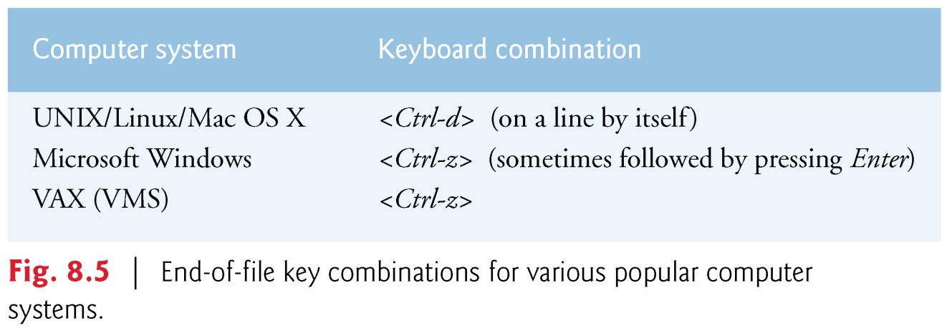

Slide 42
8.4 Creating a Sequential File (cont.)
Line 31 writes a set of data to the file clients.txt, using the stream insertion operator << and the outClientFile object associated with the file at the beginning of the program.
The data may be retrieved by a program designed to read the file (see Section 8.5).
The file created in Fig. 8.3 is simply a text file, so it can be viewed by any text editor.

Slide 43
8.4 Creating a Sequential File (cont.)
Once the user enters the end-of-file indicator, main terminates.
This implicitly invokes outClientFile’s destructor, which closes the clients.txt file.
You also can close the ofstream object explicitly, using member function close in the statement

Slide 44
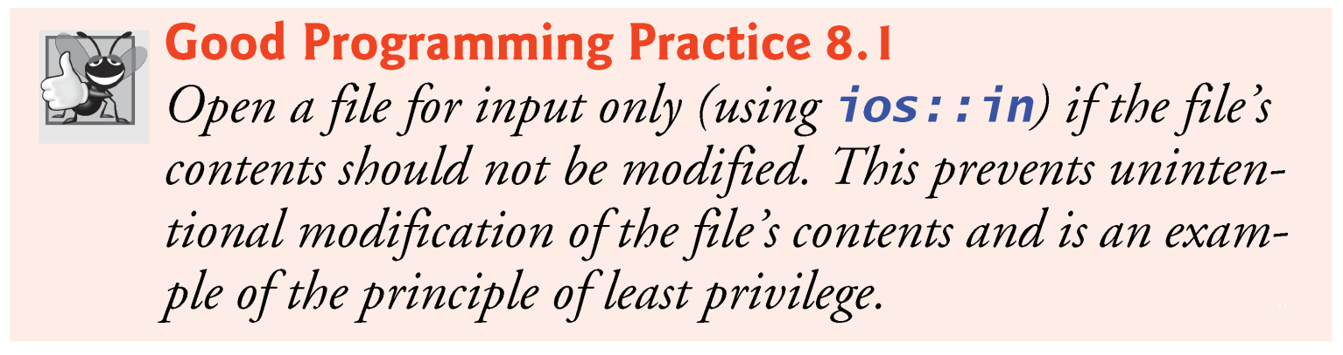

Slide 45
8.5 Reading Data from a Sequential File
Files store data so it may be retrieved for processing when needed.
In this section, we discuss how to read data sequentially from a file.
Figure 8.6 reads records from the clients.txt file that we created using the program of Fig. 8.3 and displays the contents of these records.

Slide 46
8.5 Reading Data from a Sequential File (cont.)
Creating an ifstream object opens a file for input.
The ifstream constructor can receive the filename and the file open mode as arguments.
Line 15 creates an ifstream object called inClientFile and associates it with the clients.txt file.
The arguments in parentheses are passed to the ifstream constructor function, which opens the file and establishes a “line of communication” with the file.

Slide 47
1 // Fig. 8.6: fig8_06.cpp
2 // Reading and printing a sequential file.
3 #include <iostream>
4 #include <fstream> // file stream
5 #include <iomanip>
6 #include <string>
7 #include <cstdlib>
8 using namespace std;
9
10 void outputLine( int, const string, double );
11
12 int main()
13 {
14 // ifstream constructor opens the file
15 ifstream inClientFile( "clients.dat", ios::in );
16
17 // exit program if ifstream could not open file
18 if ( !inClientFile )
19 {
20 cerr << "File could not be opened" << endl;
21 exit( 1 );
22 } // end if

Slide 48
23
24 int account; // customer’s account number
25 string name; // customer’s name
26 double balance; // amount of money customer owes company
27
28 cout << left << setw( 10 ) << "Account" << setw( 13 )
29 << "Name" << "Balance" << endl << fixed << showpoint;
30
31 // display each record in file
32 while ( inClientFile >> account >> name >> balance )
33 outputLine( account, name, balance );
34 } // end main
35
36 // display single record from file
37 void outputLine( int account, const string name, double balance )
38 {
39 cout << left << setw( 10 ) << account << setw( 13 ) << name
40 << setw( 7 ) << setprecision( 2 ) << right << balance
<< endl;
41 } // end function outputLine

Slide 49
Account Name Balance
100 Jones 24.98
200 Doe 345.67
300 White 0.00
400 Stone -42.16
500 Rich 224.62

Slide 50
while ( inClientFile >> account >> name >> balance )
cout << left << setw( 10 ) << account << setw( 13 ) << name
<< setw( 7 ) << setprecision( 2 ) << right << balance << endl;
100 Jones 24.98
200 Doe 345.67
300 White 0.00
400 Stone -42.16
500 Rich 224.62
account | 100
name | Jones
balance | 24.98
clients.dat

Slide 51
while ( inClientFile >> account >> name >> balance )
cout << left << setw( 10 ) << account << setw( 13 ) << name
<< setw( 7 ) << setprecision( 2 ) << right << balance << endl;
100 Jones 24.98
200 Doe 345.67
300 White 0.00
400 Stone -42.16
500 Rich 224.62
account | 200
name | Joe
balance | 345.67
clients.dat

Slide 52
while ( inClientFile >> account >> name >> balance )
cout << left << setw( 10 ) << account << setw( 13 ) << name
<< setw( 7 ) << setprecision( 2 ) << right << balance << endl;
100 Jones 24.98
200 Doe 345.67
300 White 0.00
400 Stone -42.16
500 Rich 224.62
account | 300
name | White
balance | 0.00
clients.dat

Slide 53
while ( inClientFile >> account >> name >> balance )
cout << left << setw( 10 ) << account << setw( 13 ) << name
<< setw( 7 ) << setprecision( 2 ) << right << balance << endl;
100 Jones 24.98
200 Doe 345.67
300 White 0.00
400 Stone -42.16
500 Rich 224.62
account | 400
name | Stone
balance | -42.16
clients.dat

Slide 54
while ( inClientFile >> account >> name >> balance )
cout << left << setw( 10 ) << account << setw( 13 ) << name
<< setw( 7 ) << setprecision( 2 ) << right << balance << endl;
100 Jones 24.98
200 Doe 345.67
300 White 0.00
400 Stone -42.16
500 Rich 224.62
account | 500
name | Rich
balance | 224.62
clients.dat

Slide 55
8.5 Reading Data from a Sequential File (cont.)
Objects of class ifstream are opened for input by default, so to open clients.txt for input we could have used the statement
ifstream inClientFile( "clients.txt" );
Just as with an ofstream object, an ifstream object can be created without opening a specific file, because a file can be attached to it later.
Each time line 32 executes, it reads another record from the file into the variables account, name and balance.
When the end of file has been reached, the while condition returns false), terminating the while statement and the program; this causes the ifstream destructor function to run, closing the file.

Slide 56
8.5 Reading Data from a Sequential File (cont.)
Reading files
ifstream inClientFile( "filename", ios::in );
!inClientFile tests if file was opened properly
while( inClientFile >> myVariable )
Stops when EOF found (gets value 0)

Slide 57
8.5 Reading Data from a Sequential File (cont.)
To retrieve data sequentially from a file, programs normally start reading from the beginning of the file and read all the data consecutively until the desired data is found.
It might be necessary to process the file sequentially several times (from the beginning of the file) during program execution.
Both istream and ostream provide member functions for repositioning the file-position pointer (the byte number of the next byte in the file to be read or written).
seekg (“ seek get”) for istream
seekp (“ seek put”) for ostream

Slide 58
while ( cin >> account >> name >> balance )
{
outClientFile << account << ' ' << name << ' ' << balance << endl;
cout << "? ";
}
clients.dat
0
1
2
3
4
5
6
7
8
9
10
11
12
13
14
15
File position
pointer
clients.dat
0
account | 100
name | Jones
balance | 24.98

Slide 59
while ( cin >> account >> name >> balance )
{
outClientFile << account << ' ' << name << ' ' << balance << endl;
cout << "? ";
}
clients.dat
0 | 00110001 | 49 | 1
1 | 00110000 | 48 | 0
2 | 00110000 | 48 | 0
3
4
5
6
7
8
9
10
11
12
13
14
15
100
File position
pointer
clients.dat
3
account | 100
name | Jones
balance | 24.98

Slide 60
while ( cin >> account >> name >> balance )
{
outClientFile << account << ' ' << name << ' ' << balance << endl;
cout << "? ";
}
clients.dat
0 | 00110001 | 49 | 1
1 | 00110000 | 48 | 0
2 | 00110000 | 48 | 0
3 | 00100000 | 32
4
5
6
7
8
9
10
11
12
13
14
15
100
File position
pointer
clients.dat
4
account | 100
name | Jones
balance | 24.98

Slide 61
while ( cin >> account >> name >> balance )
{
outClientFile << account << ' ' << name << ' ' << balance << endl;
cout << "? ";
}
clients.dat
0 | 00110001 | 49 | 1
1 | 00110000 | 48 | 0
2 | 00110000 | 48 | 0
3 | 00100000 | 32
4 | 01001010 | 74 | J
5 | 01101111 | 111 | o
6 | 01101110 | 110 | n
7 | 01100101 | 101 | e
8 | 01110011 | 115 | s
9
10
11
12
13
14
15
100 Jones
File position
pointer
clients.dat
9
account | 100
name | Jones
balance | 24.98

Slide 62
while ( cin >> account >> name >> balance )
{
outClientFile << account << ' ' << name << ' ' << balance << endl;
cout << "? ";
}
clients.dat
0 | 00110001 | 49 | 1
1 | 00110000 | 48 | 0
2 | 00110000 | 48 | 0
3 | 00100000 | 32
4 | 01001010 | 74 | J
5 | 01101111 | 111 | o
6 | 01101110 | 110 | n
7 | 01100101 | 101 | e
8 | 01110011 | 115 | s
9 | 00100000 | 32
10
11
12
13
14
15
100 Jones
File position
pointer
clients.dat
10
account | 100
name | Jones
balance | 24.98

Slide 63
while ( cin >> account >> name >> balance )
{
outClientFile << account << ' ' << name << ' ' << balance << endl;
cout << "? ";
}
clients.dat
0 | 00110001 | 49 | 1
1 | 00110000 | 48 | 0
2 | 00110000 | 48 | 0
3 | 00100000 | 32
4 | 01001010 | 74 | J
5 | 01101111 | 111 | o
6 | 01101110 | 110 | n
7 | 01100101 | 101 | e
8 | 01110011 | 115 | s
9 | 00100000 | 32
10 | 00110010 | 50 | 2
11 | 00110100 | 52 | 4
12 | 00101110 | 46 | .
13 | 00111001 | 57 | 9
14 | 00111000 | 56 | 8
15
100 Jones 24.98
File position
pointer
clients.dat
15
account | 100
name | Jones
balance | 24.98

Slide 64
8.5 Reading Data from a Sequential File (cont.)
Each istream object has a “get pointer,” which indicates the byte number in the file from which the next input is to occur, and each ostream object has a “put pointer,” which indicates the byte number in the file at which the next output should be placed.
The statement
inClientFile.seekg( 0 );
repositions the file-position pointer to the beginning of the file (location 0) attached to inClientFile.
The argument to seekg normally is a long integer.

Slide 65
8.5 Reading Data from a Sequential File (cont.)
A second argument can be specified to indicate the seek direction, which can be
ios::beg (the default) for positioning relative to the beginning of a stream,
ios::cur for positioning relative to the current position in a stream or
ios::end for positioning relative to the end of a stream
The file-position pointer is an integer value that specifies the location in the file as a number of bytes from the file’s starting location (this is also referred to as the offset from the beginning of the file).

Slide 66
8.5 Reading Data from a Sequential File (cont.)
Some examples of positioning the “get” file-position pointer are
// position to the nth byte of fileObject (assumes ios::beg) fileObject.seekg( n );
// position n bytes forward in fileObject fileObject.seekg( n, ios::cur );
// position n bytes back from end of fileObject fileObject.seekg( n, ios::end );
// position at end of fileObject fileObject.seekg( 0, ios::end );
The same operations can be performed using ostream member function seekp.

Slide 67
0 | 01100001 | 97 | a
1 | 01100010 | 98 | b
2 | 01100011 | 99 | c
3 | 01100100 | 100 | d
4 | 01100101 | 101 | e
5 | 01100110 | 102 | f
6 | 01100111 | 103 | g
7 | 01101000 | 104 | h
8
9
10
11
inFile.seekg( 0, ios::beg );
0
File position pointer

Slide 68
0 | 01100001 | 97 | a
1 | 01100010 | 98 | b
2 | 01100011 | 99 | c
3 | 01100100 | 100 | d
4 | 01100101 | 101 | e
5 | 01100110 | 102 | f
6 | 01100111 | 103 | g
7 | 01101000 | 104 | h
8
9
10
11
inFile.seekg( 2, ios::beg );
2
File position pointer

Slide 69
0 | 01100001 | 97 | a
1 | 01100010 | 98 | b
2 | 01100011 | 99 | c
3 | 01100100 | 100 | d
4 | 01100101 | 101 | e
5 | 01100110 | 102 | f
6 | 01100111 | 103 | g
7 | 01101000 | 104 | h
8
9
10
11
inFile.seekg( -1, ios::beg );
0
File position pointer
inFile.seekg( -1, ios::beg )
sets the failbit and resets the goodbit,

Slide 70
0 | 01100001 | 97 | a
1 | 01100010 | 98 | b
2 | 01100011 | 99 | c
3 | 01100100 | 100 | d
4 | 01100101 | 101 | e
5 | 01100110 | 102 | f
6 | 01100111 | 103 | g
7 | 01101000 | 104 | h
8
9
10
11
inFile.seekg( 0, ios::end );
8
File position pointer

Slide 71
0 | 01100001 | 97 | a
1 | 01100010 | 98 | b
2 | 01100011 | 99 | c
3 | 01100100 | 100 | d
4 | 01100101 | 101 | e
5 | 01100110 | 102 | f
6 | 01100111 | 103 | g
7 | 01101000 | 104 | h
8
9
10
11
inFile.seekg( -1, ios::end );
7
File position pointer

Slide 72
0 | 01100001 | 97 | a
1 | 01100010 | 98 | b
2 | 01100011 | 99 | c
3 | 01100100 | 100 | d
4 | 01100101 | 101 | e
5 | 01100110 | 102 | f
6 | 01100111 | 103 | g
7 | 01101000 | 104 | h
8
9
10
11
inFile.seekg( -3, ios::end );
5
File position pointer

Slide 73
0 | 01100001 | 97 | a
1 | 01100010 | 98 | b
2 | 01100011 | 99 | c
3 | 01100100 | 100 | d
4 | 01100101 | 101 | e
5 | 01100110 | 102 | f
6 | 01100111 | 103 | g
7 | 01101000 | 104 | h
8
9
10
11
inFile.seekg( 1, ios::end );
9
File position pointer

Slide 74
0 | 01100001 | 97 | a
1 | 01100010 | 98 | b
2 | 01100011 | 99 | c
3 | 01100100 | 100 | d
4 | 01100101 | 101 | e
5 | 01100110 | 102 | f
6 | 01100111 | 103 | g
7 | 01101000 | 104 | h
8
9
10
11
inFile.seekg( 2, ios::cur );
4
File position pointer

Slide 75
0 | 01100001 | 97 | a
1 | 01100010 | 98 | b
2 | 01100011 | 99 | c
3 | 01100100 | 100 | d
4 | 01100101 | 101 | e
5 | 01100110 | 102 | f
6 | 01100111 | 103 | g
7 | 01101000 | 104 | h
8
9
10
11
inFile.seekg( 2, ios::cur );
6
File position pointer

Slide 76
0 | 01100001 | 97 | a
1 | 01100010 | 98 | b
2 | 01100011 | 99 | c
3 | 01100100 | 100 | d
4 | 01100101 | 101 | e
5 | 01100110 | 102 | f
6 | 01100111 | 103 | g
7 | 01101000 | 104 | h
8
9
10
11
inFile.seekg( -1, ios::cur );
4
File position pointer

Slide 77
0 | 01100001 | 97 | a
1 | 01100010 | 98 | b
2 | 01100011 | 99 | c
3 | 01100100 | 100 | d
4 | 01100101 | 101 | e
5 | 01100110 | 102 | f
6 | 01100111 | 103 | g
7 | 01101000 | 104 | h
8
9
10
11
inFile.seekg( -1, ios::cur );
3
File position pointer

Slide 78
8.5 Reading Data from a Sequential File (cont.)
Member functions tellg and tellp are provided to return the current locations of the “get” and “put” pointers, respectively.
Figure 8.7 enables a credit manager to display the account information for those customers with
zero balances (i.e., customers who do not owe the company any money),
credit (negative) balances (i.e., customers to whom the company owes money), and
debit (positive) balances (i.e., customers who owe the company money for goods and services received in the past)

Slide 79
1 // Fig. 8.7: fig8_07.cpp
2 // Credit inquiry program.
3 #include <iostream>
4 #include <fstream>
5 #include <iomanip>
6 #include <string>
7 #include <cstdlib>
8 Using namespace std;
9
10 enum RequestType { ZERO_BALANCE = 1, CREDIT_BALANCE,
DEBIT_BALANCE, END };
11 int getRequest();
12 bool shouldDisplay( int, double );
13 void outputLine( int, const string, double );

Slide 80
14
15 int main()
16 {
17 // ifstream constructor opens the file
18 ifstream inClientFile( "clients.dat", ios::in );
19
20 // exit program if ifstream could not open file
21 if ( !inClientFile )
22 {
23 cerr << "File could not be opened" << endl;
24 exit( 1 );
25 } // end if
26
27 int request;
28 int account;
29 string name;
30 double balance;

Slide 81
31
32 // get user's request (e.g., zero, credit or debit balance)
33 request = getRequest();
34
35 // process user's request
36 while ( request != END )
37 {
38 switch ( request )
39 {
40 case ZERO_BALANCE:
41 cout << "\nAccounts with zero balances:\n";
42 break;
43 case CREDIT_BALANCE:
44 cout << "\nAccounts with credit balances:\n";
45 break;
46 case DEBIT_BALANCE:
47 cout << "\nAccounts with debit balances:\n";
48 break;
49 } // end switch
50

Slide 82
51 // read account, name and balance from file
52 inClientFile >> account >> name >> balance;
53
54 // display file contents (until eof)
55 while ( !inClientFile.eof() )
56 {
57 // display record
58 if ( shouldDisplay( request, balance ) )
59 outputLine( account, name, balance );
60
61 // read account, name and balance from file
62 inClientFile >> account >> name >> balance;
63 } // end inner while
64
65 inClientFile.clear(); // reset eof for next input
66 inClientFile.seekg( 0 ); // move to beginning of file
67 request = getRequest(); // get additional request from user
68 } // end outer while
69
70 cout << "End of run." << endl;
71 } // end main

Slide 83
72
73 // obtain request from user
74 int getRequest()
75 {
76 int request;
77
78 // display request options
79 cout << "\nEnter request" << endl
80 << " 1 - List accounts with zero balances" << endl
81 << " 2 - List accounts with credit balances" << endl
82 << " 3 - List accounts with debit balances" << endl
83 << " 4 - End of run" << fixed << showpoint;
84
85 do // input user request
86 {
87 cout << "\n? ";
88 cin >> request;
89 } while ( request < ZERO_BALANCE && request > END );
90
91 return request;
92 } // end function getRequest

Slide 84
93
94 // determine whether to display given record
95 bool shouldDisplay( int type, double balance )
96 {
97 // determine whether to display credit balances
98 if ( type == CREDIT_BALANCE && balance < 0 )
99 return true;
100
101 // determine whether to display debit balances
102 if ( type == DEBIT_BALANCE && balance > 0 )
103 return true;
104
105 // determine whether to display zero balances
106 if ( type == ZERO_BALANCE && balance == 0 )
107 return true;
108
109 return false;
110 } // end function shouldDisplay
111

Slide 85
112 // display single record from file
113 void outputLine( int account, const string name,
double balance )
114 {
115 cout << left << setw( 10 ) << account << setw( 13 ) << name
116 << setw( 7 ) << setprecision( 2 ) << right << balance
<< endl;
117 } // end function outputLine

Slide 86
Enter request
1 - List accounts with zero balances
2 - List accounts with credit balances
3 - List accounts with debit balances
4 - End of run
? 1
Accounts with zero balances:
300 White 0.00
Enter request
1 - List accounts with zero balances
2 - List accounts with credit balances
3 - List accounts with debit balances
4 - End of run
? 2
Accounts with credit balances:
400 Stone -42.16

Slide 87
Enter request
1 - List accounts with zero balances
2 - List accounts with credit balances
3 - List accounts with debit balances
4 - End of run
? 3
Accounts with debit balances:
100 Jones 24.98
200 Doe 345.67
500 Rich 224.62
Enter request
1 - List accounts with zero balances
2 - List accounts with credit balances
3 - List accounts with debit balances
4 - End of run
? 4
End of run.

Slide 88
8.6 Updating Sequential Files
Data that is formatted and written to a sequential file as shown in Section 8.4 cannot be modified without the risk of destroying other data in the file.
For example, if the name “White” needs to be changed to “Worthington,” the old name cannot be overwritten without corrupting the file.
The record for White was written to the file as
300 White 0.00
If this record were rewritten beginning at the same location in the file using the longer name, the record would be
300 Worthington 0.00
The new record contains six more characters than the original record.

Slide 89
8.6 Updating Sequential Files
Example: change name "White" to "Worthington"
Old data
300 White 0.00 400 Jones 32.87
Insert new data
300 Worthington 0.00
300 White 0.00 400 Jones 32.87
300 Worthington 0.00ones 32.87
Data gets overwritten

Slide 90
8.6 Updating Sequential Files (cont.)
Therefore, the characters beyond the second “o” in “Worthington” would overwrite the beginning of the next sequential record in the file.
The problem is that, in the formatted input/output model using the stream insertion operator << and the stream extraction operator >>, fields—and hence records—can vary in size.
For example, values 7, 14, –117, 2074, and 27383 are all ints, which store the same number of “raw data” bytes internally (typically four bytes on today’s popular 32-bit machines).
However, these integers become different-sized fields when output as formatted text (character sequences).
Therefore, the formatted input/output model usually is not used to update records in place.

Slide 91
8.6 Updating Sequential Files (cont.)
Such updating can be done, but a bit awkwardly.
For example, to make the preceding name change
the records before 300 White 0.00 in a sequential file could be copied to a new file
the updated record then written to the new file
and the records after 300 White 0.00 copied to the new file.
This requires processing every record in the file to update only one record.
If many records are being updated in one pass of the file, though, this technique can be acceptable.

